Slide 1
Highway Planning & Design
Lecture - 2
Designed and presented
By
Asst. Prof. Dr. Raquim Nihad Zehawi

Slide 2
Highway Design Standards
The first step in the design of any highway is the selection of the appropriate set of geometric design standards
There is no single set of geometric standards can be used for all highways
The characteristics of the highway should be considered in selecting the geometric design standards
Width of Travel Lanes
Shoulders
1- Design Hourly Volume
Medians
Roadside and Median Barriers
2- Design Speed
5- Cross-Section Elements
Curbs and Gutters
3- Design Vehicle
Guard Rails
Sidewalks
4- Maximum Highway Grades
Cross Slopes
Right of Way

Slide 3
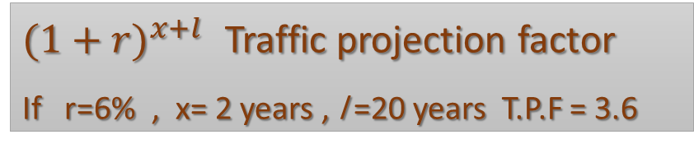


1- Design Hourly Volume
The design hourly volume (DHV) is the projected hourly volume (up to the design year) that is used for design
It is usually taken as a percentage of the expected ADT on the highway
It is referred to as “Annual Average Daily Traffic” (AADT) for it is the:
annual traffic averaged on a daily basis in both directions
Projected “Future” (AADT)
The average daily traffic is estimated for the future depending on many factors that influence its growth
The future average daily traffic is calculated:
$(1+{r)}^{x+l}$ Traffic projection factor
If r=6% , x= 2 years , l =20 years T.P.F = 3.6
$$F=C (1+{r)}^{n}$$
$$n=x+l$$
F= future traffic (AADT)
C= current traffic
r = annual rate of increase of traffic
x= years of construction
l : is the average design life (years)

Slide 4

The DHV is typically between the 10th and 50th highest volume hour of the year
The 30th-highest hourly volume is usually selected as the DHV
The 30th-highest hourly volume for rural highways is usually between 12 and 18 percent of the ADT
K-factor is the ratio between DHV and AADT

Slide 5

Directional distribution factor (D) is the Factor reflecting the proportion of peak-hour traffic traveling in the peak direction
Directional design-hour volume (DDHV) is calculated

Slide 6
2- Design Speed
Design speed is defined as a selected speed to determine the various geometric features of the roadway.
the functional classification of the highway
It depends on:
the topography of the area
the land use of the adjacent area
Level terrain: relatively flat. Horizontal and vertical sight distances are long
Rolling terrain: has natural, occasional steep slopes that often restrict the normal vertical and horizontal alignments.
For highway design, topography is:
Mountainous terrain: has sudden changes in ground elevation in both the longitudinal and transverse directions

Slide 7
Design speeds range from 20 mi/h to 70 mi/h, with intermediate values of 5 mi/h increments
freeways are designed for 60 to 70 mi/h
design speeds for other arterial roads range from 30 mi/h to 60 mi/h

Slide 8
3- Design Vehicle
The design vehicle is: The largest vehicle that is likely to use the highway with considerable frequency
A design vehicle is selected to represent all vehicles on the highway
Its weight, dimensions, and operating characteristics are used to establish the design standards of the highway
It is used to determine critical design features such as radii at intersections and turning roadways as well as highway grades

Slide 9
4- Maximum Highway Grades
The selection of maximum grades for a highway depends on the design speed and the design vehicle
Steep grades affect the performance of heavy vehicles as well as that of of passenger cars
grades of 4 to 5 percent have little or no effect on passenger cars
Maximum grades have been established based on the operating characteristics of the design vehicle
Minimum grades depend on the drainage conditions of the highway
Zero percent grades may be used on uncurbed pavements with adequate cross slopes
Longitudinal grade should be provided, when pavements are curbed
It is customary to use a minimum of 0.5 - 3 percent in such cases

Slide 10
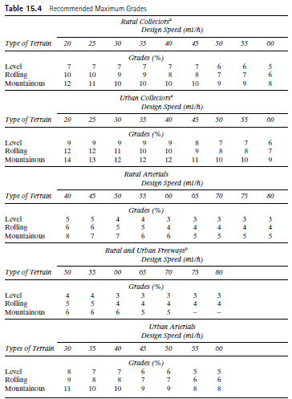

Slide 11
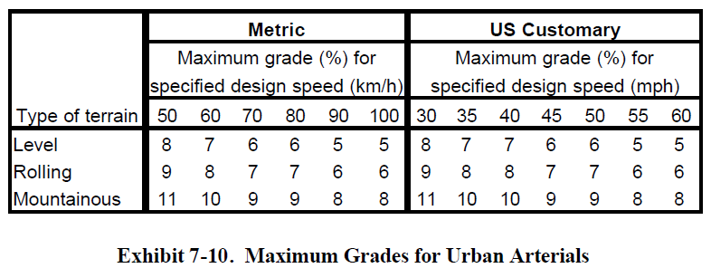

Slide 12
5- Cross-Section Elements
The principal elements of a highway cross section
The marginal elements of a highway cross section
1- barriers
1- travel lanes
2- curbs and gutters
2- shoulders
3- guard rails
4- sidewalks
3- medians
5- cross Slopes
6- side slopes
7- right of way

Slide 14
1- Width of Travel Lanes
Travel lane widths usually vary from 9 to 12 ft. Most arterials have 12-ft travel lanes
The capacity of a highway decreases significantly as the lane width is reduced from 12 ft,
2- Shoulders
The shoulder is always contiguous with the traveled lane so as to provide an area along the highway for vehicles to stop when necessary
Shoulder width range from 2 ft on minor roads to 12 ft on major arterials
Shoulders are also used to laterally support the pavement structure
The shoulder width is known as either graded or usable
shoulder width is measured from the edge of the pavement to the intersection of the shoulder slope and the plane of the side slope
Recommended slopes are 2 to 6 percent for bituminous and concrete-surfaced shoulders, and 4 to 6 percent for gravel or crushed-rock shoulders

Slide 15
3- medians
It is the section of a divided highway that separates the lanes in opposing directions.
The width of a median is the distance between the edges of the inside lanes
Median widths vary from a minimum of 4 to 80 ft or more
The functions of a median include:
• Providing a recovery area for out-of-control vehicles
• Separating opposing traffic
• Providing stopping areas during emergencies
• Providing storage areas for left-turning and U-turning vehicles
• Providing refuge for pedestrians
• Reducing the effect of headlight glare
• Providing temporary lanes and cross-overs during maintenance operations

Slide 16
The marginal elements of a highway cross section
1- barriers
median barrier is a longitudinal system used to prevent an errant vehicle from crossing the portion of a divided highway separating the traveled ways for traffic in opposite directions
Roadside barriers protect vehicles from obstacles or slopes on the roadside
They also may be used to shield pedestrians and property from the traffic stream.
2- curbs and gutters
Curbs are raised structures that are used mainly on urban highways to delineate (define) pavement edges and pedestrian walkways
Curbs are also used to: control drainage, improve aesthetics, and reduce right of way
Gutters (drainage ditches) are usually located on the pavement side of a curb to provide the principal drainage facility for the highway
usually have cross slopes of 5 to 8 percent and are 1 to 6 ft wide

Slide 18
3- guard rails
Guard rails are the longitudinal barriers placed on the outside of sharp curves and at sections with high fills. Their main function is to prevent vehicles from leaving the roadway
installed at embankments higher than 8 ft and when shoulder slopes are greater than 4:1
The weak post system provides for the post to collapse on impact, with the rail deflecting and absorbing the energy due to impact
4- sidewalks
Sidewalks are usually provided on roads in urban areas (uncommon in rural areas)
Generally, sidewalks should be provided when pedestrian traffic is high along main or high-speed roads in either rural or urban areas

Slide 19
5- cross Slopes
Pavements on straight sections of two-lane and multilane highways without medians are sloped from the middle downward, resulting in a transverse or cross slope
the highest point of the pavement (called the crown) is slightly rounded
Cross slopes on divided highways are provided by either crowning the pavement in each direction, or by sloping the entire pavement in one direction
w
Straight line camber
w
Parabolic shape
parabolic
stright
stright
w
Combination

Slide 20
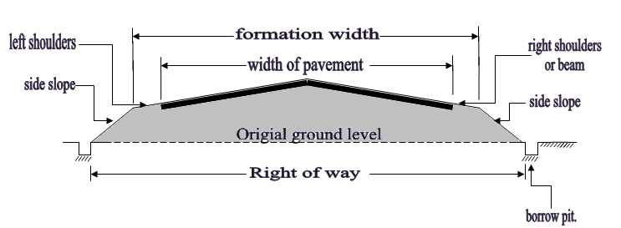
6- side slopes
Side slopes are provided on embankments and fills to provide stability for earthworks. They also serve as a safety feature by providing a recovery area for out-of-control vehicles.
7- right of way
The right of way is the total land area acquired for the construction of a highway. The width should be sufficient to accommodate all the elements of the highway cross section, any planned widening of the highway, and public-utility facilities that will be installed along the highway.

